Slide 1

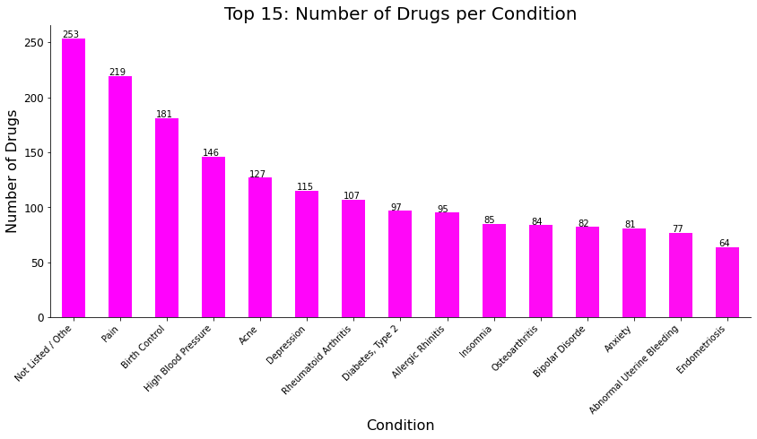
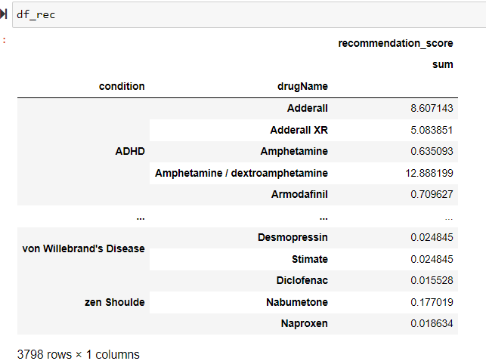
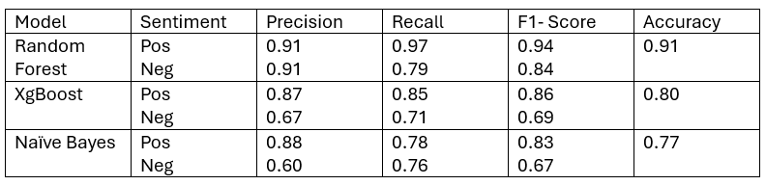
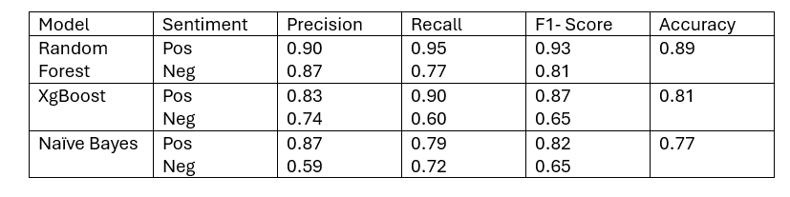
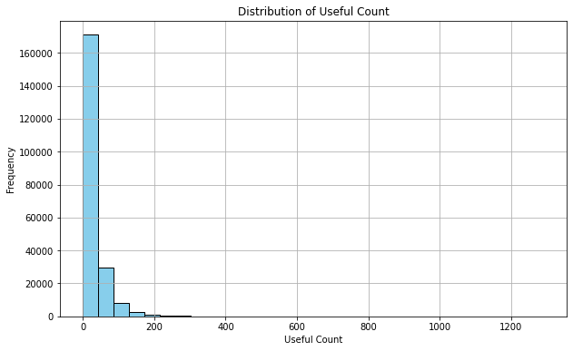
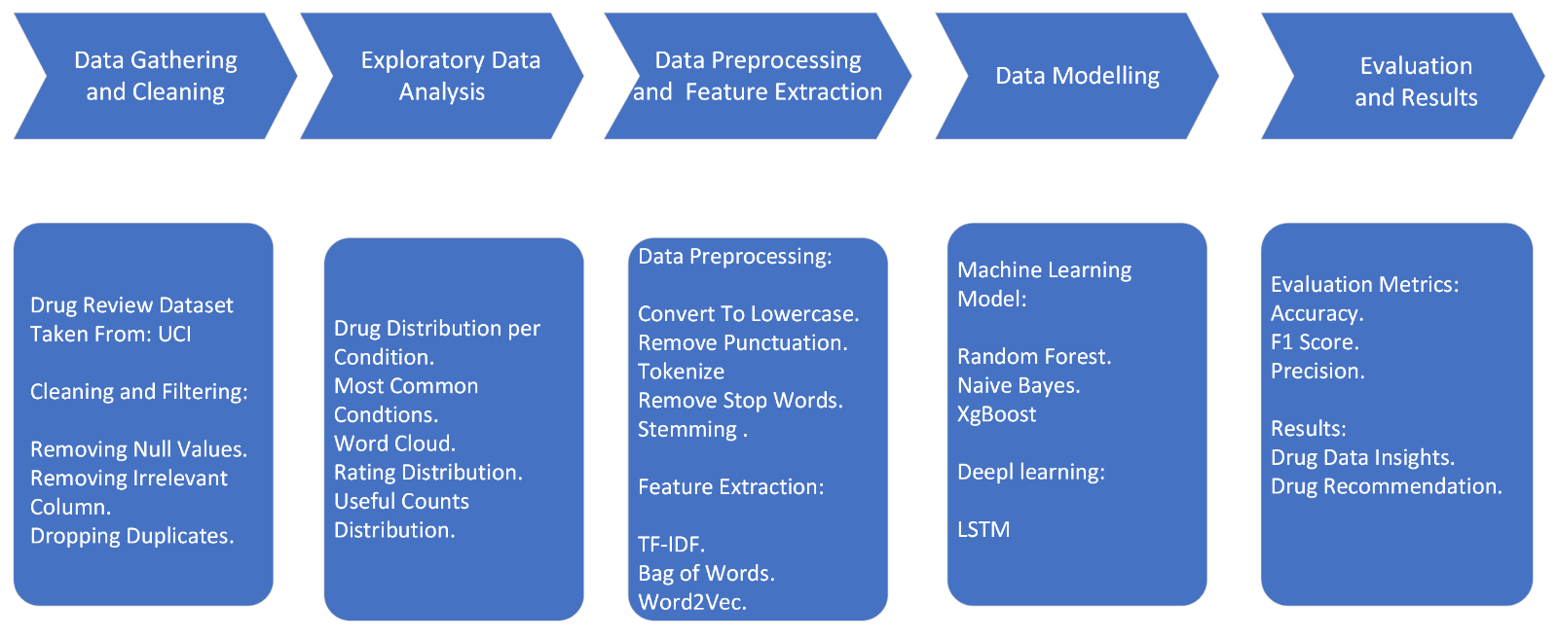
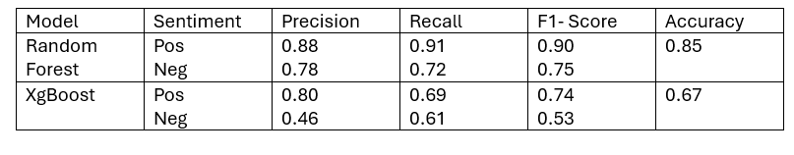
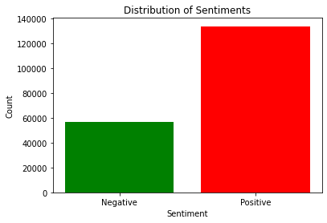
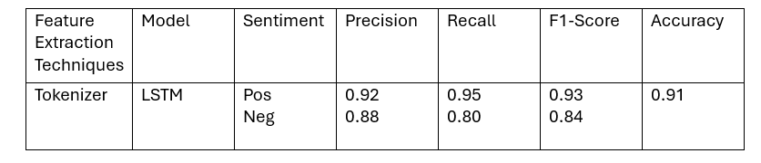
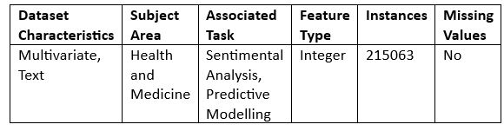

Medicine Recommendations Using Sentimental Analysis of Drugs Reviews
Rutik Rajeshkumar Kothwala
CS668, Analytics Capstone Seidenberg School of Computer Science & Information Systems
INTRODUCTION
ANALYSIS
Results From Machine Learning Models
DRUG RECOMMENDER SYSTEM
Medication errors are among the most common medical errors, harming at least 1.5 million people every year.
One of the largest costs of this is incorrectly prescribed medication.
The cost of this misadventures to the US economy is more than $177 billion per year.
User-generated reviews, especially about medications are abundant, they can be helpful to regulatory agencies, pharmaceutical companies and healthcare professionals.
Text mining on drug reviews will be useful to face the major challenge of medication error. However, it is not feasible to go through each of these comments by hand.
Machine learning techniques have proven to be effective in analyzing large volumes of data and extracting meaningful insights. Therefore, sentimental analysis and machine learning models can be used on drugs reviews to prepare desired recommendation framework.
Results Obtain From TF - IDF
The diagram illustrates the top 15 medical conditions for which the highest number of drugs are available. It is evident that several conditions have over 100 drugs available to treat them.
Therefore there is a need to develop a recommendation model that could recommend the best drug for a given condition.
Random Forest gives the best result compared to the other two models by giving the highest accuracy of 0.91% followed by XgBoost with 0.80% accuracy and the least accuracy observed with Naïve Bayes of 0.77%, Although the accuracy of XgBoost is higher than Naïve Bayes but Naïve bayes works well with both the class as compared to Xgboost.
Results Obtain From Bag Of Words
After evaluating all the models results of the best model from each feature extraction technique are added and then multiplied by the normalized useful count. This was done to minimize the error in drug recommender as even if one method as predicted wrong the overall score will be less.
OBJECTIVES
To conduct in-depth exploratory data analysis of the Drug Review Dataset
To do Sentiment analysis on drug reviews by different feature extraction techniques.
To develop a drug recommendation framework by predictive modeling leveraging machine learning and deep learning algorithms
It is readily apparent that the distribution of useful counts is highly uneven, with a significant level of deviation. This suggests that some reviews receive a notably higher number of useful counts compared to others. So we have to normalize it while creating our recommendations score
CONCLUSION
It is evident that the results closely resemble those of TF-IDF, with Random forest exhibiting the best performance, followed by XGBoost and Naïve Bayes. Notably, all three models demonstrate strong performance, with accuracy ranging from 77% to 89%.
The Random Forest model excels in drug recommendation frameworks with a remarkable performance across various feature extraction techniques with the highest 0.91 with TF-IDF.
Deep learning models are a promising alternative to basic machine learning models matching the best accuracy with just 50 epochs.
Future works may involve employing different oversampling techniques to enhance recall value and hypertuning can be done to optimize model performance.
Furthermore, instead of combining model results, using proper ensemble techniques could give a more robust recommendation score.
METHODOLOGY
Results Obtain From Word2Vec
SMOTE TECHNIQUE
When model was run the result for positive reviews were quite good but models were not performing well on negative reviews as our dataset is imbalance positive reviews number were much higher then negative ones so to overcome this issues SMOTE Technique was used.
Applied SMOTE Technique on train data to address class imbalance by oversampling the minority class (in this case negative reviews).
We can see Random forest perform well giving accuracy 85% while Xgboost performance was not that good giving accuracy of only 67% comparatively less than Random forest., Naïve Bayes is not used because negative vectors were also incorporated into the analysis using Word2Vec, Naïve Bayes models are not compatible with negative vectors
REFERENCES
DATASET DESCRIPTION
[1] Sentimental Analysis in social media and its applications: Systematic Literature Review by Zulfadzli Drus, Haliyana Khalid.
[2] Sentiment Analysis using product review data Xing Fang & Justin Zhan Journal of Big Data, Article number 5.
[3] Comparing deep learning architectures for sentiment analysis on drug reviews by
Cristóbal Colón-Ruiz and Isabel Segura-Bedmar from Journal of Biomedical Informatics.
[4] Drugs reviews sentiment analysis using weakly supervised model by Zhang Min,
publisher IEEE.
[5] DLRS: Deep Learning-Based Recommender System for Smart Healthcare
Ecosystem.by, Gagangeet Singh Aujla; Anish Jindal; Rajat Chaudhary; Neeraj Kumar;
Sahil Vashist; Neeraj Sharma; Mohammad S. Obaidat, publisher IEEE.
[6] Deep Learning based Chatbot Architecture for Medical Diagnosis and Treatment
Recommendation.by Girish Rajani, Khusi Ruparel, publisher IEEE.
[7] National Library of Medicine-National Healthcare Quality and Disparities Report.
[8] Getting Started with Sentiment Analysis using Python by Federico Pascual on
Huggingface.
[9] Sentimental Classification of Drug Reviews Using Machine Learning Techniques by
Mohammad Al-Ameen A. Hameed; Khalid Shaker; Haitham A. Khalaf.
For our research, drug review dataset is selected from UCI Machine Learning Repository. The UCI ML Drug Review dataset provides patient reviews on specific drugs along with related conditions and a 10-star patient rating system reflecting overall patient satisfaction. The data was obtained by crawling online pharmaceutical review sites.
Results From Deep Learning Model
An LSTM model utilizing tokenizer techniques achieves an accuracy of 0.91 with 50 epochs, which is the performance of the best machine learning model. LSTMs is used instead of traditional RNNs due to their ability to remember long-term dependencies, making them better at capturing the nuanced relationships between words in text data.

